Slide 1

Basic Details of the Team and Problem Statement
Ministry/Organization Name/Student Innovation: National Technical Research Organisation(NTRO)
PS Code: 1454
Problem Statement Title: Create an intelligent system using AI/ML to detect phishing domains which imitate look and feel of genuine domains
Team Name: Phishing Threat Defenders
Team Leader Name: Ravi Solanki
Institute Code (AISHE):
Institute Name: National Technical Research Organisation,(NTRO)
Theme Name: Blockchain and Cybersecurity

Slide 2
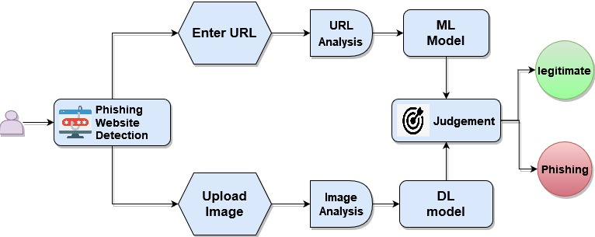
Idea/Approach Details
Idea/Solution
Begin with diverse domain datasets, including legitimate and phishing domains.
Advanced machine learning techniques are used to analyze web page content and structure, allowing the system to identify between authentic and phishing domains.
Utilize deep learning technique with the VGG16 pre-trained model to identify visual distinctions among websites, particularly those mimicking genuine layouts.
Establish a real-time monitoring strategy to detect and respond to new phishing domains as they develop, thereby lowering the window of potential.
Create an easy user interface that allows security experts to quickly access and comprehend detection data.
Technology Stack
Data collection: Open Source Database, Web scraping
Machine Learning: Python, Scikit Learn, NLTK
Deep Learning: Tensorflow, Keras
Web Development: Flask, HTML, Python, CSS
Chatbot: Azure Cognitive Services
Model Deployment: AWS / Azure
Real Time Management: Apache Kafka

Slide 3
Idea/Approach Details
Use Cases
Show Stopper
Enterprise Email Security: The system safeguards businesses from email phishing.
Financial Services Fraud Prevention: The system's role in financial security through phishing domain detection and fraud prevention.
Government Cybersecurity: The system protects government agencies from phishing threats, including disinformation campaigns, safeguarding critical infrastructure and national security.
E-commerce Fraud Prevention: The system identifies fake e-commerce sites, enhancing online shopper safety and trust.
Social Media Safety: Our system's part in securing social media platforms by detecting and blocking phishing links, and preventing scams.
Data imbalance: With more legitimate domains, hampers training and may reduce phishing detection accuracy.
Adversarial Evasion: Sophisticated adversaries can craft phishing domains to evade detection, posing a constant challenge to staying ahead of evolving tactics.
False Positives: Balancing accurate detection with minimal false positives is challenging, as high false positives can disrupt user experience.
Real-Time Detection: Achieving real-time detection while minimizing latency is essential for preventing user access to malicious sites.

Slide 4
Team Member Details
Team Leader Name: Ravi Solanki
Branch: BSc Data Science Stream: IT Year: III
Team Member 1 Name: Shani Darji
Branch: BSc AIML Stream: IT Year: III
Team Member 2 Name: Manav Patel
Branch: BSc AIML Stream: IT Year: III
Team Member 3 Name: Meet Solanki
Branch: BSc AIML Stream: IT Year: III
Team Member 4 Name: Shreya Shah
Branch: BSc AIML Stream: IT Year: III
Team Member 5 Name: Vrunda Bhuva
Branch: BSc AIML Stream: IT Year: III
Team Mentor 1 Name: Type Your Name Here
Category (Academic/Industry): Expertise (AI/ML/Blockchain etc): Domain Experience (in years):
Team Mentor 2 Name: Type Your Name Here
Category (Academic/Industry): Expertise (AI/ML/Blockchain etc): Domain Experience (in years):

